Slide 1
Data Loss Prevention with Matthew Anderson and Kevin Stribling

Slide 2
Data Loss Prevention – Table of Contents
Four Pillars of Data Loss Prevention
Data Breach Information
Data Loss Protection – Identify Data section
Data Loss Protection – Protect Your Data
Data Loss Protection – Prevent Data Loss
Data Loss Protection – Govern Your Data
Data Loss Prevention and Plymouth State University Financial Aid

Slide 3
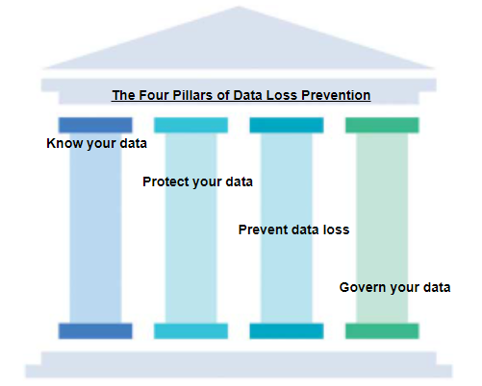
Four Pillars of Data Loss Prevention
Notes:
Kevin

Slide 4
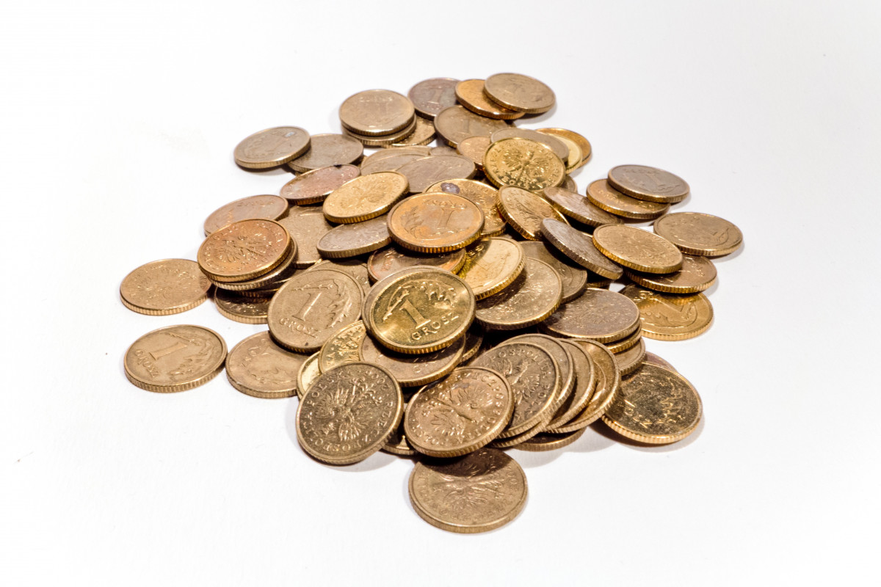
When your data is not protected
Three-quarters of all data breaches that happen in the education sector happen where?
What is the average data breach cost for a University or College?
How much did Arizona’s Maricopa County Community College system data breach cost?
Out of 17 industry sectors that are monitored for data breaches how does the higher education sector rank?
Notes:
Kevin

Slide 5
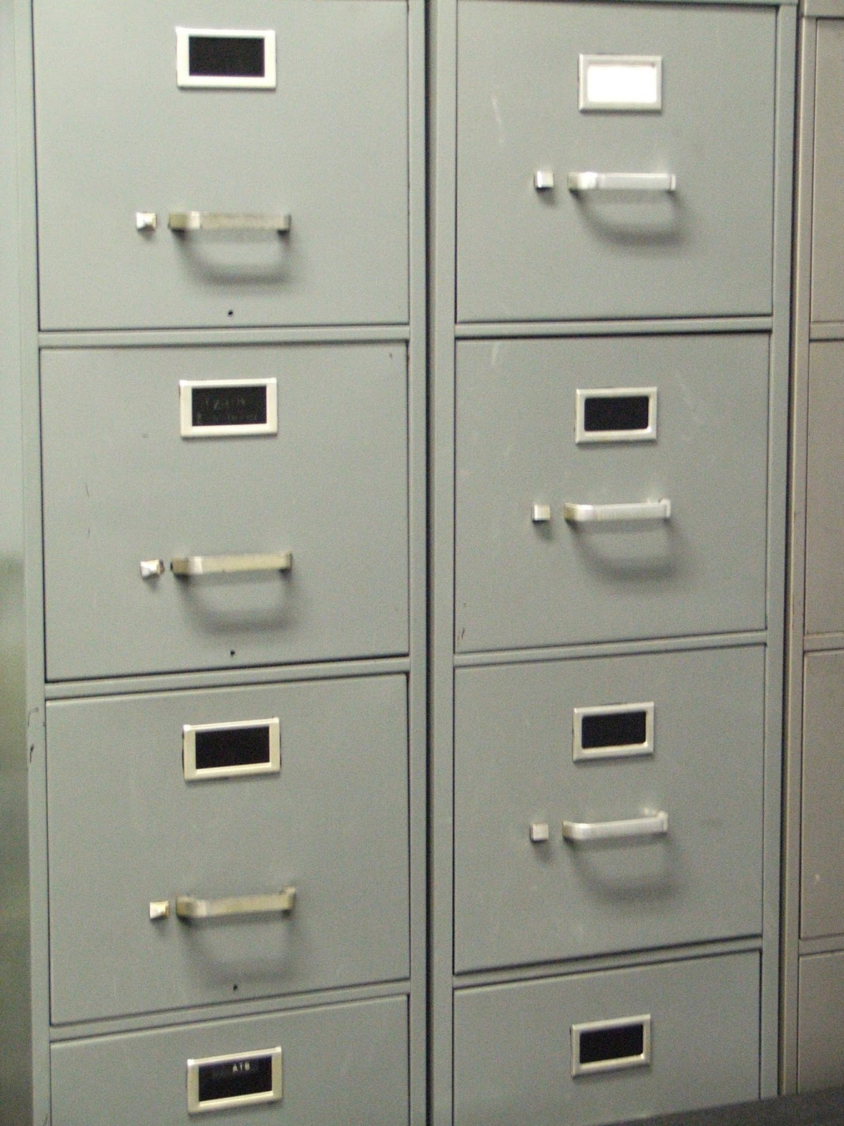
Data Loss Prevention – Identify Data
USNH brief history of data management.
Microsoft's Data Loss Prevention (DLP) is the new approved tool.
Microsoft’s Data Loss Protection (DLP) can identify institutional data in many places.
Single pane of glass.
This Photo by Unknown Author is licensed under CC BY-NC
Notes:
Kevin

Slide 6
UNSH – Intuitional Data Policy Review
Restricted Data – Tier 4
Protected Data – Tier 3
Sensitive Data – Tier 2
Public Data – Tier 1
https://www.usnh.edu/policy/usy/viii-cybersecurity-policies-and-standards/information-classification
Notes:
Matthew

Slide 7
Data Loss Protection - Identify Data
Where should my data live? What is a good location for my data?
SharePoint should be used for what type of data?
OneDrive should be used for what type of data?
Restricted data should not live locally on your laptop. There are exceptions made by Cyber Security Governance Risk and Compliance. Cybersecurity GRC.
This Photo by Unknown Author is licensed under CC BY-SA
Notes:
Matthew

Slide 8
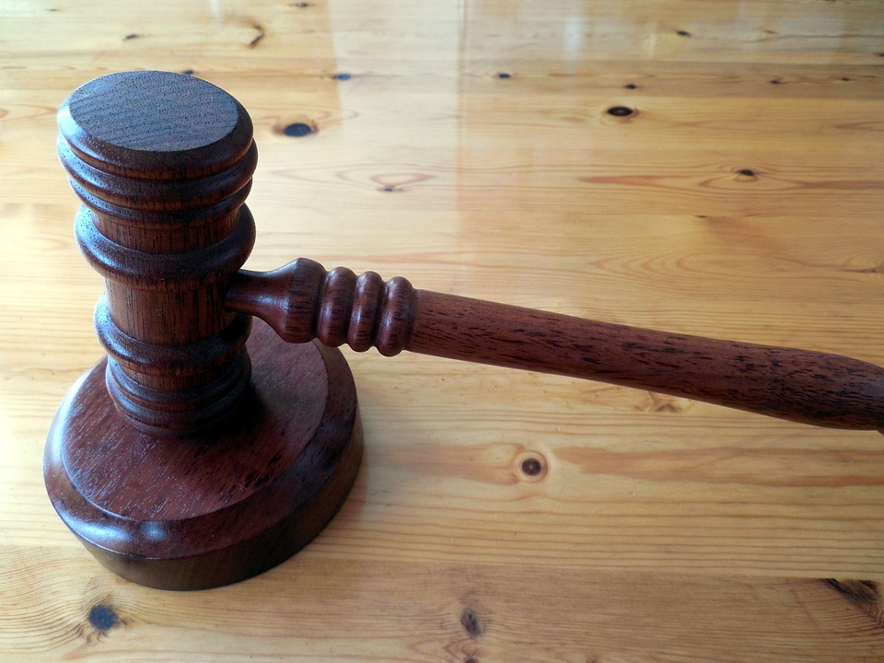
Data Loss Protection - Identify Data
Who is Cybersecurity?
How does data loss prevention find where data lives?
What is a Classifier?
Alerting on data?
Notes:
Kevin

Slide 9
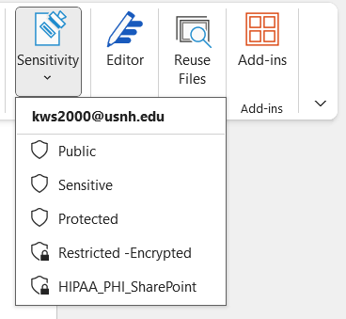
Data Loss Protection – Protect Your Data
How can Microsoft’s Data Loss Prevention help the University System of New Hampshire protect its data?
Data Loss Prevention policies and classifiers have been previously mentioned.
Sensitivity Labels
This Photo by Unknown Author is licensed under CC BY-NC
Notes:
Matthew

Slide 10
Data Loss Protection – Prevent Data Loss
How can you prevent data loss?
Adapt, change, paradigm shift, or stay the same.
Who can help?
This Photo by Unknown Author is licensed under CC BY-ND
Notes:
Kevin

Slide 11
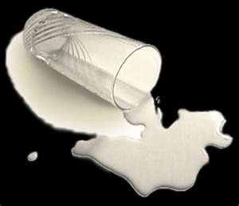
Data Loss Protection – Govern Your Data
Data Governance
Who can and who should not access your data?
How does data governance work?
Examples
Whoops….. What if I make a mistake?
This Photo by Unknown Author is licensed under CC BY-SA
Notes:
Matthew

Slide 12
Data Loss Prevention – The Meeting
Plymouth State University Financial Aid
Notes:
Kevin

Slide 13
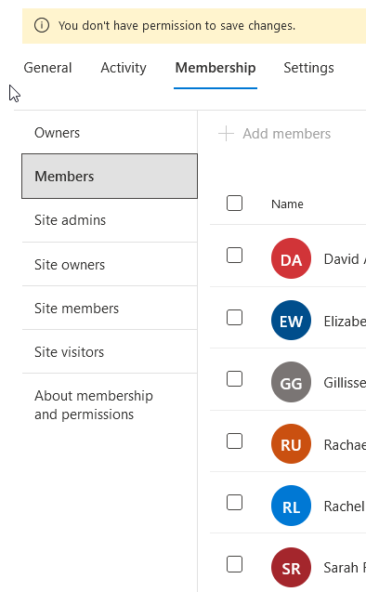
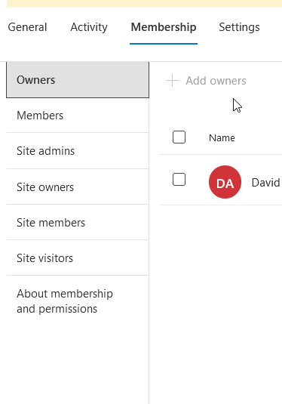
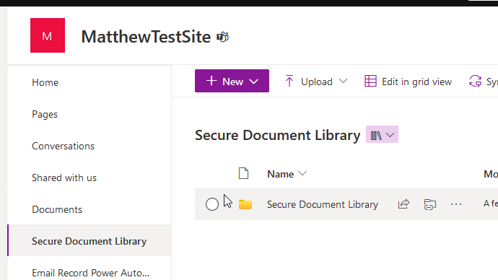
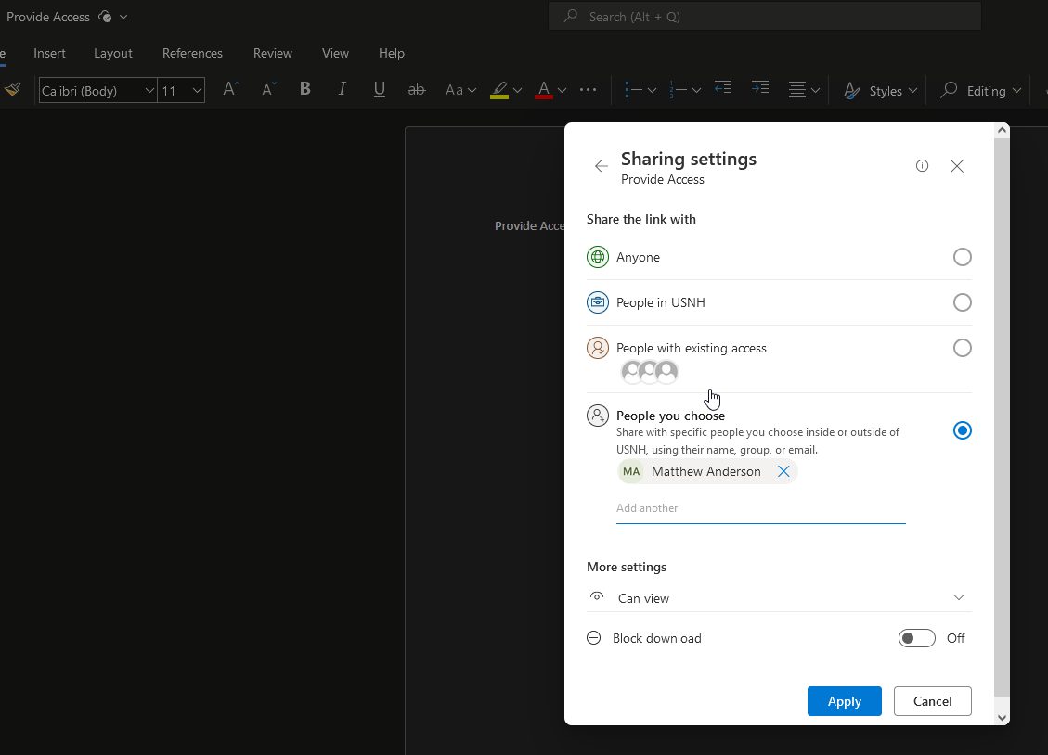
What Does a Secure SharePoint looks like
Few owners.
Members with separate permissions.
Secure Document Library and Public Document library with separate permissions, or separate SharePoint Sites.
Members dictate access with links to documents and folders that are customized to the person they are providing access to.
All Restricted, Protected and Sensitive information is stored in one place, the owners know where that is, and who has access to it.
Privacy settings on the SharePoint sites are configured by Administrators or through the use of Site Sensitivity Labels to control external access to SharePoint sites.
Document Libraries that contain Restricted, Protected, or Sensitive information are labeled with Sensitivity labels to prevent unintentional access by allowing only specific users access to the encrypted contents.
DLP policies are applied to those SharePoint sites to generate alerts when Restricted, Protected, or Sensitive information is not stored in the correct Document library.
Items in Green are configured by the owners of the site
Items in Red are configured by coordinating with IT Administrators.
Notes:
Matthew

Slide 14
Questions & Answers
Data Loss Prevention attendees may ask questions now.

