Slide 1
Shark Academy
Become a shark in the ocean of phishing
Alina Stechyshyn,
USNH Cybersecurity Analyst

Slide 2
Phishing attacks are on the rise
Phishing attacks: # 1 attack in higher ed now.
Phishing attacks: 95% of all cyber-attacks on enterprise networks
UNH: email filtering policies + security operations folks
Email is scanned for malware, phishing and spam is moved to Junk folder
Problem: automatic detection is not enough

Slide 3
Phishing Emails
Phishing emails – a form of social engineering, involving the sending of legitimate looking emails aimed at fraudulently extracting sensitive information from recipients, usually for a financial gain.
Psychological nature of phishing
Risks: financial, reputational, psychological
No technology can stop all phishing – communication is key
We are all in this together

Slide 4
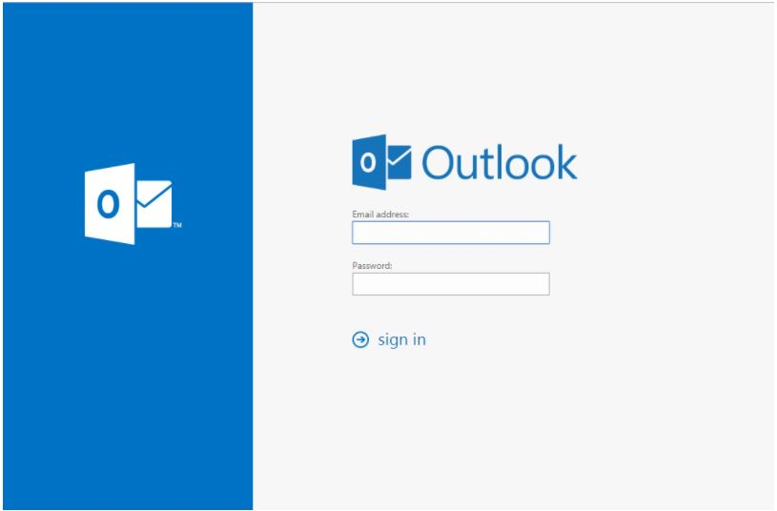
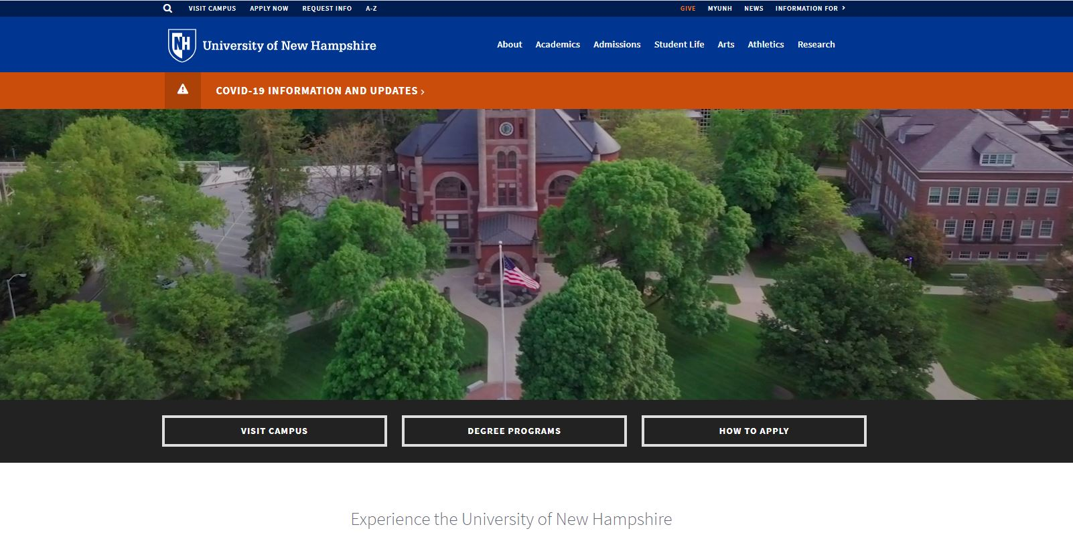
How Phishing Works
Criminals create a hook - fake login page
Recon
Email with a link to fake login is sent
Victims fall for these scam jobs and lose money
Use collected credentials to send other phishing like scam jobs
UNICEF Internship
Pet Sit to Get Paid
Document shared with you: "DC.docx"

Slide 5
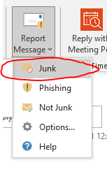
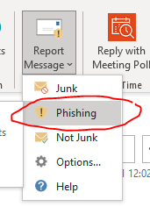
What emails can you expect to see?
The Good
Expected emails from the people you know personally.
The Bad = Spam/Junk
Unexpected advertisements from marketing companies.
The Ugly = Phishing
Unexpected emails with malicious intent, asking you to do something urgently.

Slide 6
Is it Phishing or Spam? Check the Sender Address
Who is the sender?
The first step is to always check the full sender address, its domain. Does the sender address make sense? Is it consistent with the UNH domain?
Likely SPAM
Likely PHISH
Likely PHISH

Slide 7
Does Email Text make sense?
Next, read the email. Does the email make sense? What is it asking you to do?
SPAM/JUNK

Slide 8
Does Email Text make sense?
PHISH

Slide 9
Does Email Text make sense?
PHISH

Slide 10
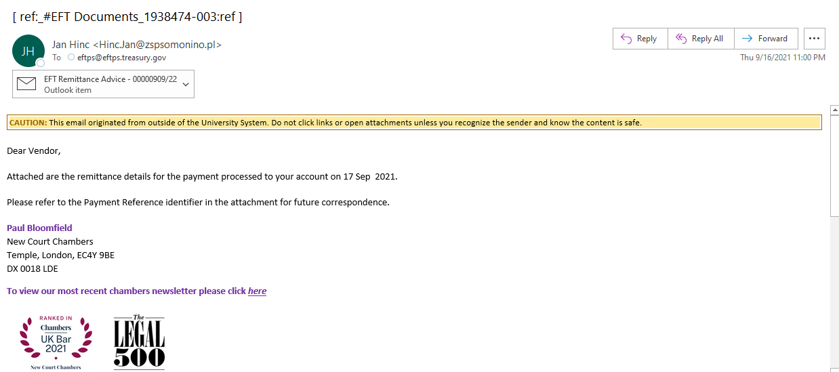
Phishing with Malware Attached in Another Email
By attaching malware in another email attachment, attackers avoid our scanners:

Slide 11
Malicious html attachment

Slide 12
Internal Phishing
PHISH

Slide 13
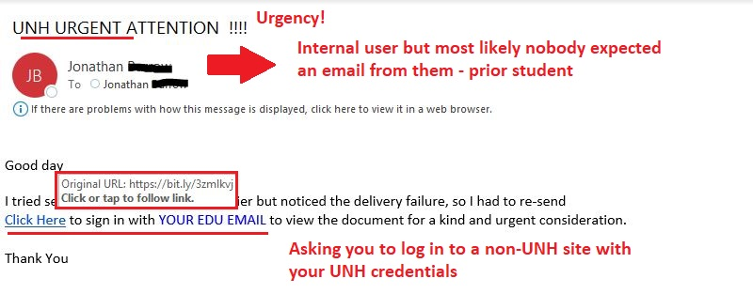
UNH example Break-Down

Slide 14
URLs can be analyzed without Clicking
Does the URL in the email make sense? What is its domain?
PHISH
PHISH
SPAM/JUNK

Slide 15
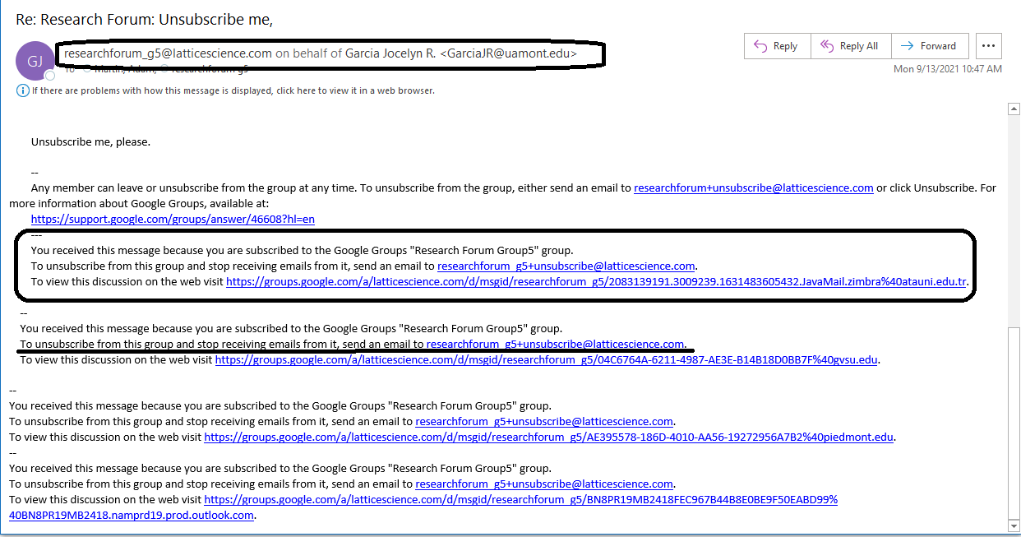
Phishing that collects active emails to use in other phishing
Unknown sender
Asking to Unsubscribe from an Unknown group
Not so innocent

Slide 16
Is it Phishing or Spam? (External)
PHISH
Spoofed Sender: Name <meltwill001@gmail.com>

Slide 17
Is it Phishing or real? Confirm the Request via University Email
PHISH

Slide 18
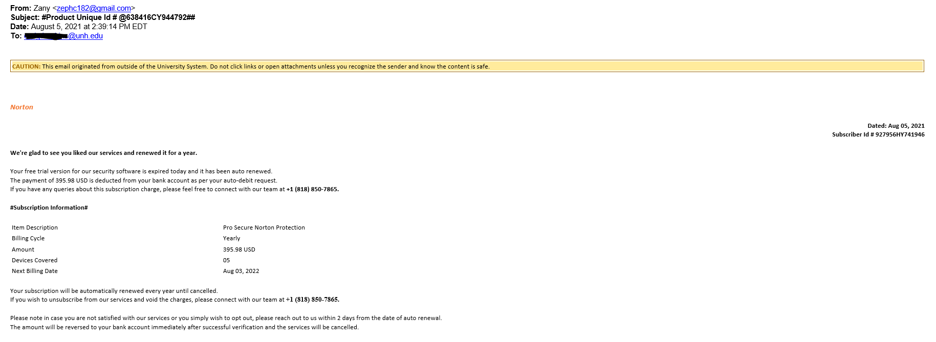
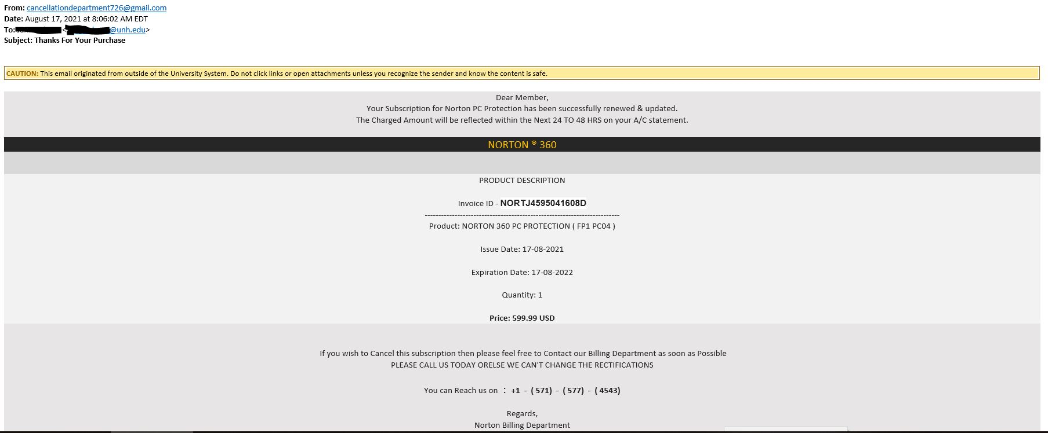
Tech Support Scams
PHISH
PHISH

Slide 19
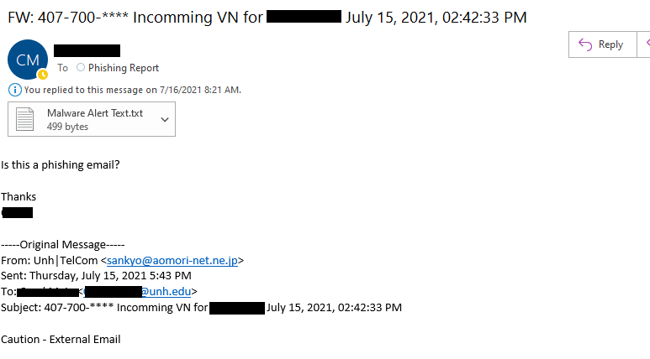
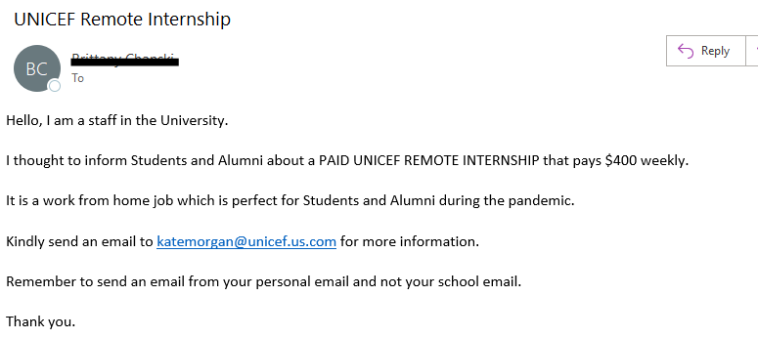
Types of Phishing at UNH
Credential Collection
Sender asks you to confirm your password, or reactivate your account
Involves links to fake Login pages
Uses valid credentials to access email and distribute malicious message to all contacts.
Download malware
Emails try to convince the recipient to click the URL or open an attachment.
Spear Phishing – gift card scams
Spoofing a familiar name, asking for your quick help to purchase gift cards.
Job scams
Emails with easy jobs that pay well, which in fact involve fraudulent activity.

Slide 20
Phishing Indicators
Sender address claims to be from UNH/PSU/KSC/GSC/USNH, but the email domain is not.
Name <meltwill001@gmail.com>
Sender is internal to UNH/USNH, but he is email is unexpected and the offer sounds too good to be true
Urgency
Bad Grammar
Asks you to email to a non-UNH email address

Slide 21
Your Actions for Unexpected Emails
Read the email, notice the sender.
Wait, let it sink in, don’t act on it right away.
Try to categorize it: spam/junk or phishing.
Check PhishBowl.
Use “Report It” button to report it as Junk or Phishing.
Forward it to phishing.report@unh.edu if you have questions.

Slide 22
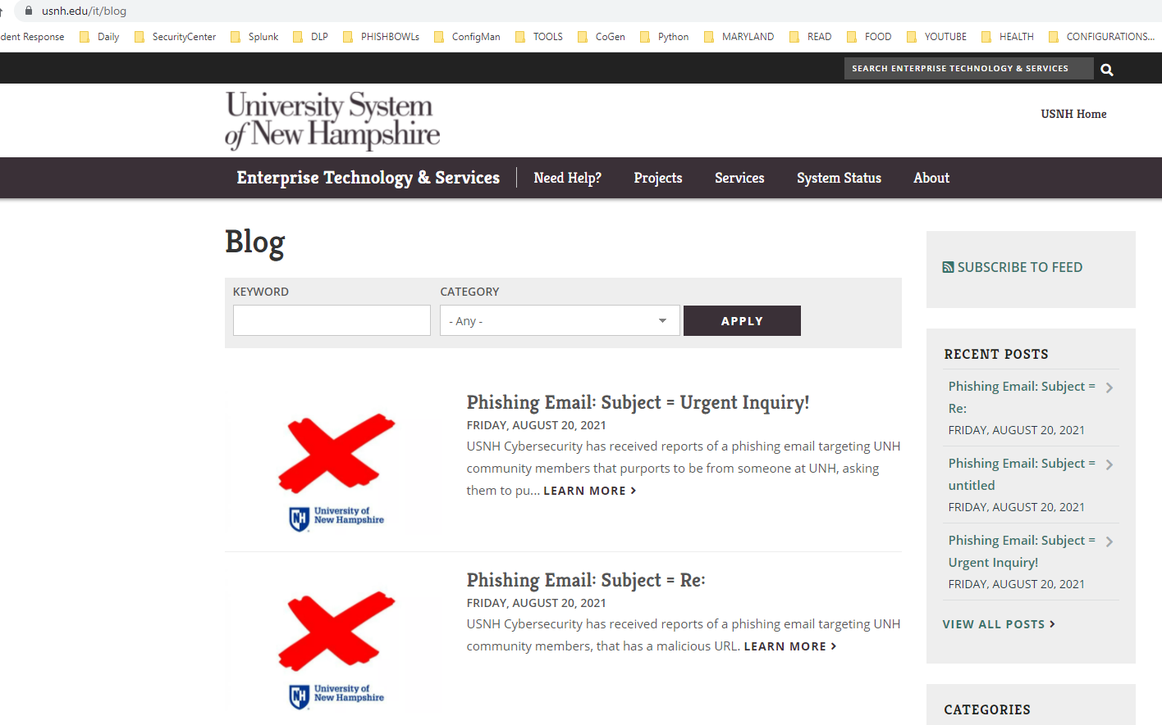
Your actions
Check USNH PhishBowl
https://www.usnh.edu/it/blog
Any questions? – Forward to phishing.report@unh.edu

Slide 23
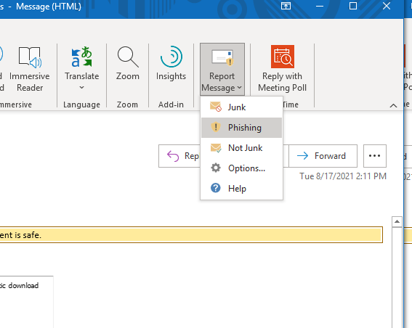
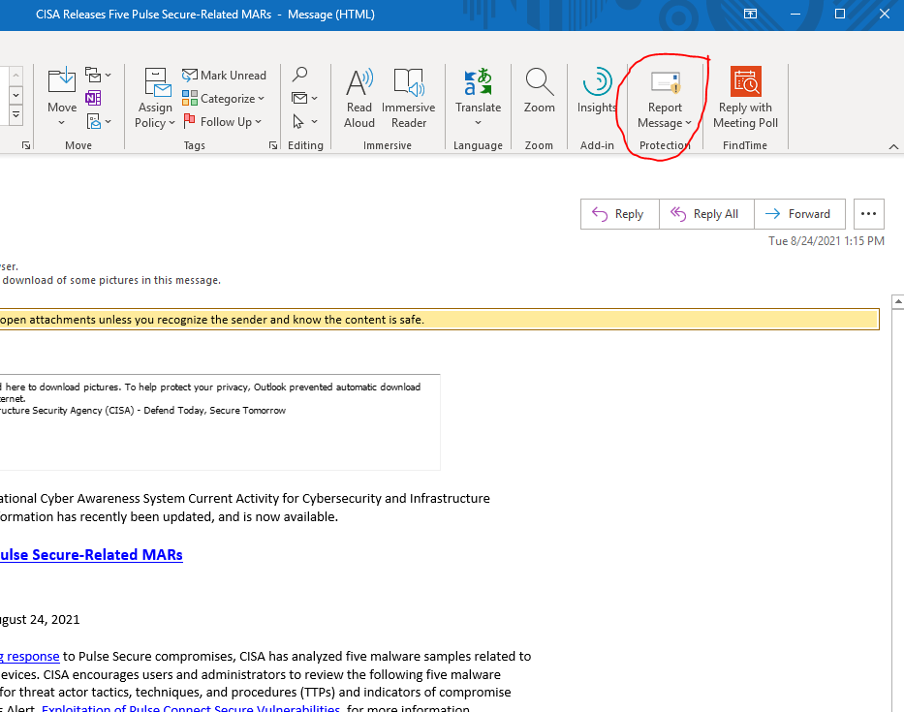
Your Actions
Report message as Phishing or Junk
Finally, delete the email

Slide 24
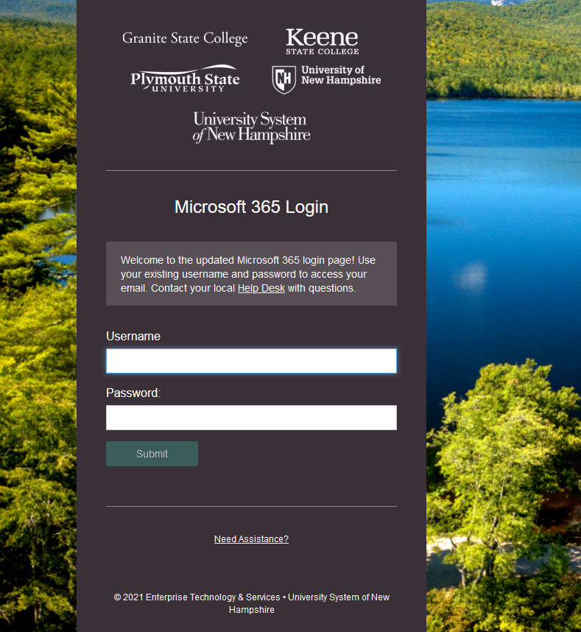
UNH Login Page
Check the address bar
https://mylogin.unh.edu/...
Close the browser tab

Slide 25
UNH, GSC Password Change

Slide 26
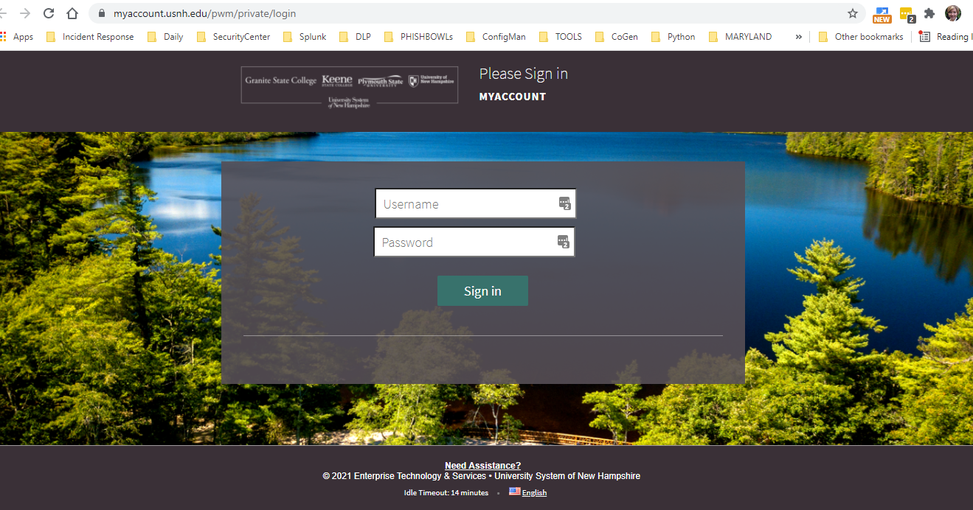
NEW Password Change page coming

Slide 27
NEW Password Change page coming

Slide 28
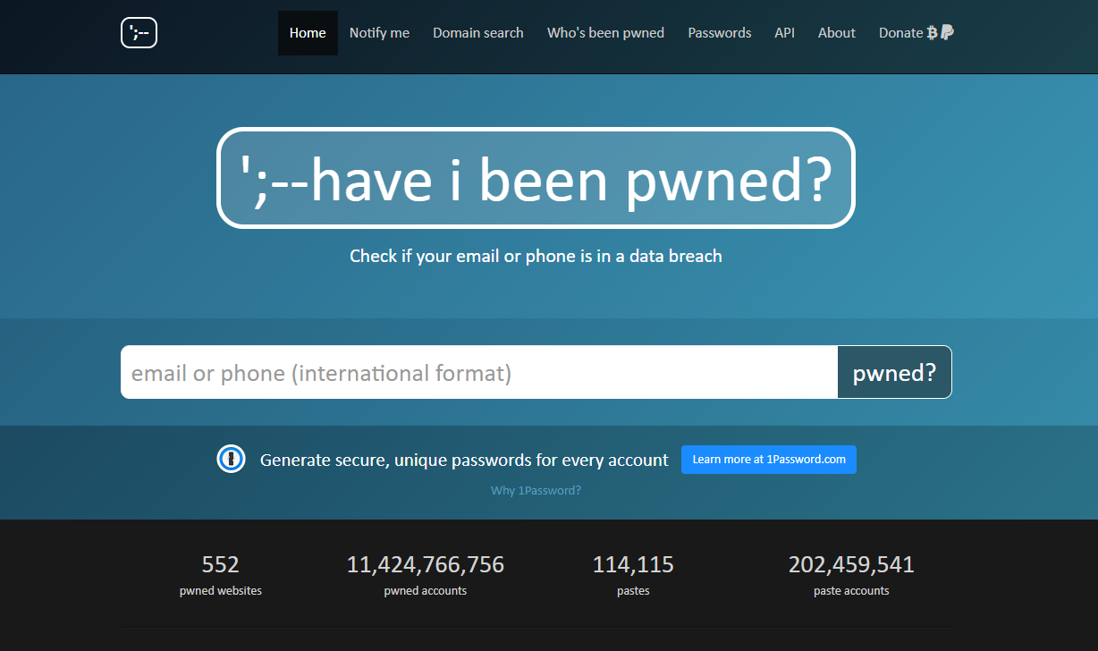
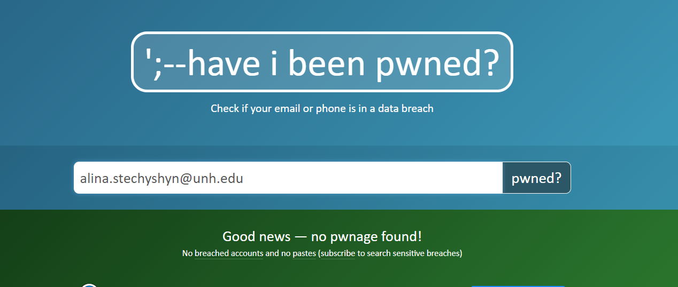
Have your passwords been publicly posted?
https://haveibeenpwned.com/

Slide 29
Security is everybody’s responsibility.
Questions???

