Slide 1
Cybersecurity Career Academy
Thomas Nudd
Chief Information Security Officer - USNH

Slide 2
Agenda
My Cybersecurity Career Path
What is Cybersecurity?
Business is Booming!
What are the Different Roles?
So you want to be a Cyber Pro?
What are some resources to learn from?
Ok, I have learned some things, how do I prove it?
The Big Reveal!
Disclaimer – Slides contain my thoughts and opinions based on my career experiences ☺

Slide 3
My Cybersecurity Career Path
BS – Marketing and International Business – UMaine
Marketing Intern – Stonewall Kitchen
Market Management – Liberty Mutual
MBA – SNHU
------ Re-Org -------
Cybersecurity Career Begins
MS Information Assurance – Norwich University
Vuln Management -> Log Management -> Incident Response -> SysAdmin -> Cybersecurity Engineer -> Building a SOC -> Director of Cybersecurity Engineering -> Director of Cloud Security Engineering -> CISO USNH.

Slide 4
What is Cybersecurity?
“Cybersecurity is the art of protecting networks, devices, and data from unauthorized access or criminal use and the practice of ensuring confidentiality, integrity, and availability of information.” - CISA
Security Hacker:
https://en.wikipedia.org/wiki/Security_hacker
https://en.wikipedia.org/wiki/List_of_security_hacking_incidents
Computer Security:
https://en.wikipedia.org/wiki/Computer_security
Books:
Cult of the Dead Cow
Ghost In The Wires
The Cuckoos’s Egg
The Fifth Domain
Counter Hack Reloaded

Slide 5
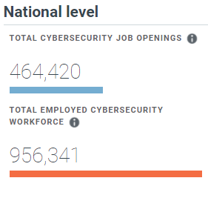
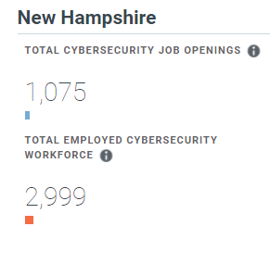
Business is Booming!
“Cybersecurity workers protect our most important and private information, from bank accounts to sensitive military communications.”
Cyberseek Project supported by The National Initiative for Cybersecurity Education (NICE), led by the National Institute of Standards and Technology (NIST)

Slide 6
Specialized Job Roles in Cybersecurity
Cybersecurity Engineer
Cybersecurity Risk Analyst
Privacy Analyst / Engineer
Cybersecurity Compliance Analyst
Cybersecurity Incident Responder
Cybersecurity Vulnerability Analyst
Security Operations Center (SOC) Engineer / Blue Team
Penetration Tester / Certified Ethical Hacker (CEH) / Red Team
Cybersecurity Threat Analyst
Cybersecurity Developer
Cybersecurity Data Scientist
Cybersecurity Leadership BISO / CISO / CSO

Slide 7
So You Want to be a Cyber Pro?
Key Traits I Look For When Hiring (In Priority Order)
Ability to lead complex initiatives and diverse groups of people
Ability to solve complex problems under pressure
Decisiveness
Ability to communicate clearly
Proactiveness and willingness to learn
Ability to work through adversity
Foundational technical skillset
Cybersecurity technical skillset

Slide 8
Resources (Free!)
CIS - The Center for Internet Security is an independent, nonprofit organization with a mission to create confidence in the connected world.
CIS Top 20
Hardening Templates
NIST - The National Institute of Standards and Technology is a physical sciences laboratory and non-regulatory agency of the United States Department of Commerce.
NIST CSF
NIST 800 - 53
CISA - The Cybersecurity and Infrastructure Security Agency leads the Nation’s strategic and unified work to strengthen the security, resilience, and workforce of the cyber ecosystem to protect critical services and American way of life.
Referential Guidance
OWASP - The Open Web Application Security Project (OWASP) is a nonprofit foundation that works to improve the security of software.
OWASP Top 10

Slide 9
More Resources (Free!)
CSA - The Cloud Security Alliance is the world’s leading organization dedicated to defining and raising awareness of best practices to help ensure a secure cloud computing environment.
White Papers and Referential Guidance
SANS Institute – The SysAdmin, Audit, Network, and Security Institute offers comprehensive, intensive training designed to help anyone, from auditors to CIOs to defend systems and networks against the most dangerous threats.
Internet Storm Center
Reading Room
Private Tech Industry – Microsoft, Amazon, Verizon, Google, Cisco, VMware, IBM
Published white papers, reference architectures, comprehensive documentation, RTFM.
Cybersecurity News Outlets – Krebs, IT Security Guru, Security Weekly, Hacker News, Blogs
Free Tools and YouTube – Download them, Watch and Learn!

Slide 10
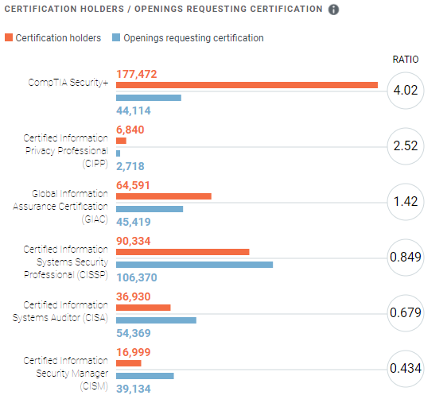
Ok I Have Learned a Bit, How Can I Prove It?
Be Proactive and APPLY THY KNOWLEDGE
Projects
Labs
Personal Life
@Work
Certifications
SANS
ISC^2
CSA
CEH
ISACA
CompTIA
Higher Education

Slide 11
The Big Reveal
You Already Are A Cybersecurity Professional.
You Are Our First Line of Defense.
Thank you!

